Slide 1
Power BI Embedded

Slide 2

Announcing Microsoft Power BI Embedded preview
An Azure service for Power BI
Notes:
Announce the service
In case they missed the //Build announcement
Call out that it is different from the SaaS service
This is primarily a service for ISVs

Slide 3

Power BI Embedded Conceptual Model
1,N
Microsoft Azure subscription
Developer
1,N
Workspace collection
Name
Admin Users
Endpoints
Keys
Gateways
Credentials
Geo Location
Tags
Azure SQL Database
Azure SQL Data Warehouse
1,N
on Azure HDInsight
Workspace
Name
Reports
Datasets
Tags
Embed
Your app
End users
Notes:
A Workspace Collection is a 1st class Azure resource
Workspace Collections can be provisioned in Ibiza
More Ibiza functionality to follow, including managing Workspaces & Reports

Slide 4
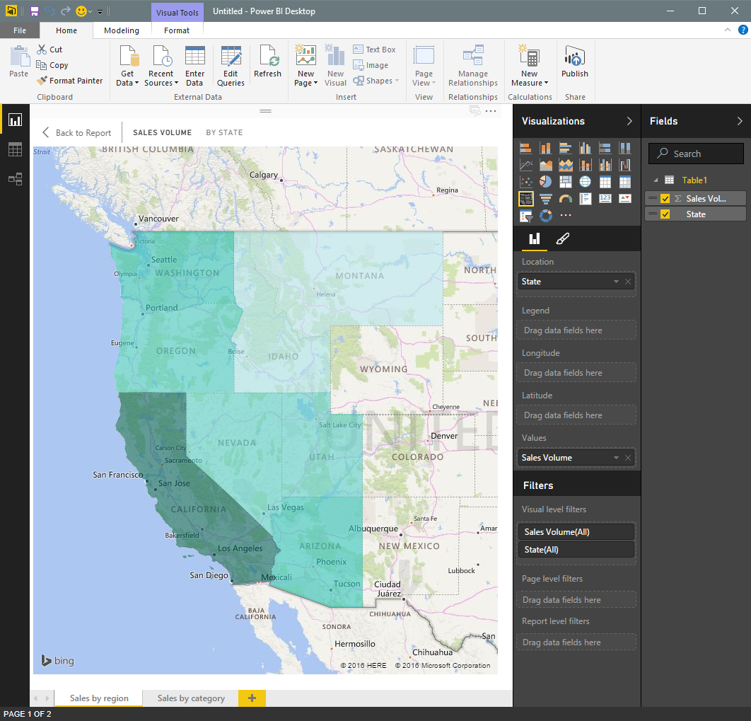
Easily author interactive reports for free in Power BI Desktop
Shape data into the format and structure you need
Produce rich data models using formulas and relationships
Explore data through a freeform, drag-and-drop canvas
Publish interactive data visualizations to your app
Create
Embed
Deploy
Notes:
Today, the only authoring experience is the Desktop tool
Windows only, no x-plat story
In future, the web designer will be expanded to support authoring for embedded reports
Manage reports (.pbix) as dev resources
No Excel authoring

Slide 5
Keep visuals up to date using DirectQuery
Azure SQL Database
Connect directly to the source without moving your data
Build visualizations over very large datasets
Azure SQL Data Warehouse
Power BI report
Your app
on Azure HDInsight
Create
Embed
Deploy
Notes:
The set of data sources for Embedded is more limited than the SaaS product
No Vertipaq (cube) behind reports, so DirectQuery needs to be optimized for each report
Can embed data into report, but not a very interesting scenario for ISVs

Slide 6
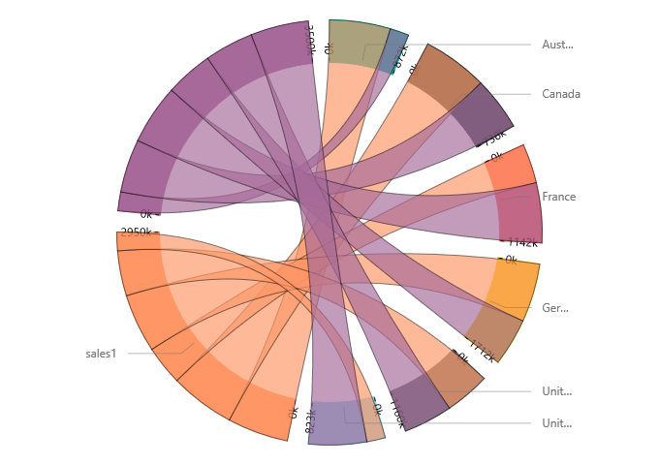
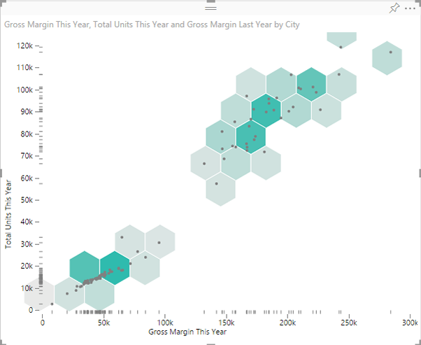
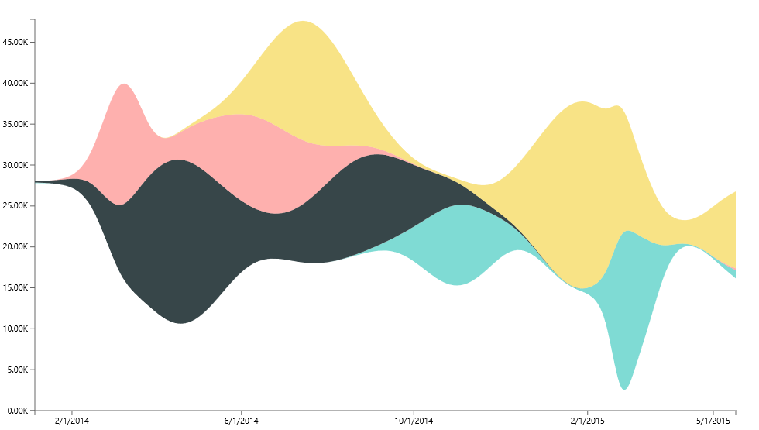
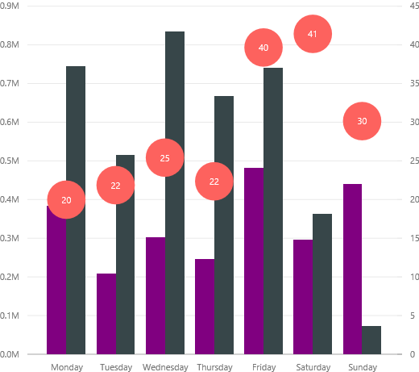
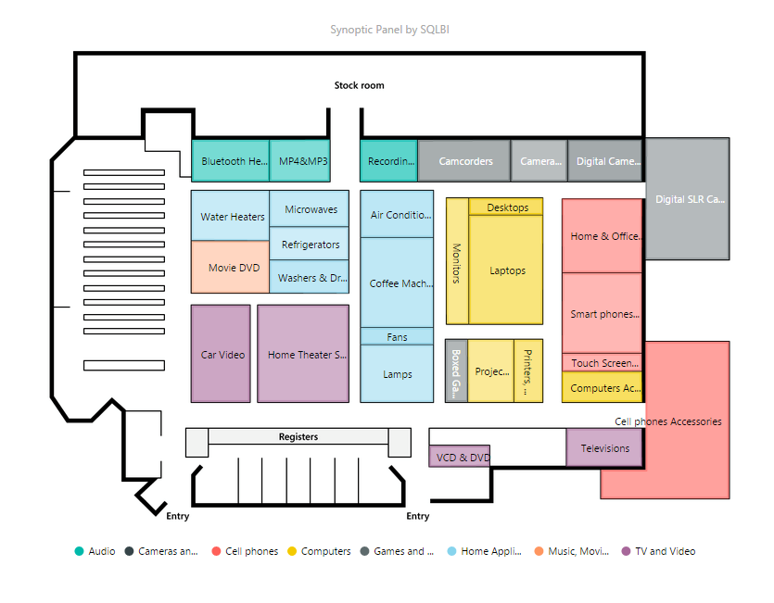
Get started quickly with Microsoft’s open-sourced, production-quality visualization code
Leverage the visualization framework, test suite and tooling to build the right custom visuals for your app
Create
Embed
Deploy
Notes:
Charts are pre-built for you
Take advantage of new visual styles for charts
Visualize your data in new ways
To help you get started, we’ve published the code for all of our visualizations to GitHub.
. All of this is available as an open source project on GitHub. You can also visit www.powerbi.com/visuals to visit our community authored visuals gallery , download visuals and get started.

Slide 7

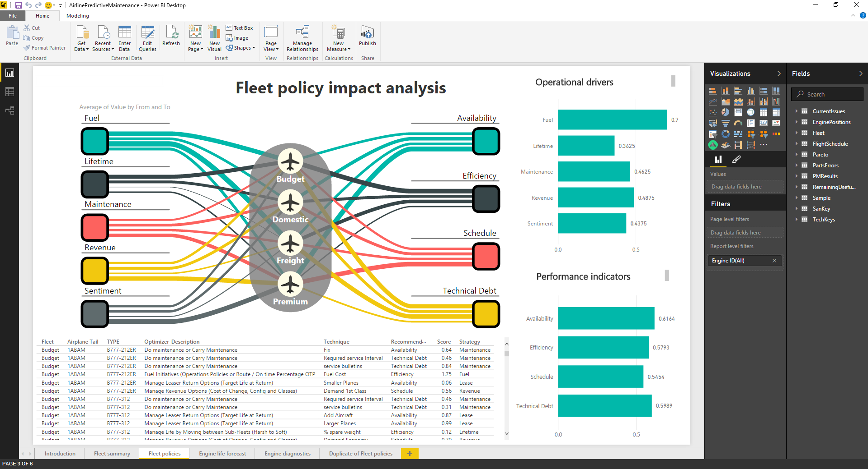
Workshop
Create Reports
Notes:
https://powerbi.microsoft.com/en-us/industries/airline

Slide 8

Embed data experiences easily on any device for immediate value
Easily embed interactive visuals in your app using REST APIs and the Power BI SDK
Ensure consistent high-fidelity data experiences across any device
Provide friction-free authentication and authorization experiences
Realize faster time-to-value without redesigning your app
Create
Embed
Deploy

Slide 9
Power BI Embedded API surface
Your app
Power BI APIs
Discovery: Enumerate datasets and reports
Content Creation: Provision datasets and reports
Embed: Embed reports
Utility: Set connection strings and credentials
Programmatic
REST APIs
Azure Resource Manager API
Azure APIs for automation
Microsoft Azure
Power BI Embedded
Platform
Provision workspace collections
De-provision workspace collections
Manage API keys
Azure SQL Database
Azure SQL Data Warehouse
Spark on Azure HDInsight
Data
Create
Embed
Deploy
Notes:
Full suite of APIs to manage & discover reports & data sources

Slide 10
Addressing the APIs
Https://
API.PowerBI.com
Beta
collections
{Workspace Collection Name}
https://api.powerbi.com/beta/collections/{workspace collection name}/
Notes:
A Workspace Collection is the top-level of organization for reports & data sources
Full Azure RBAC may be applied to this entity type

Slide 11
Workspace
https://api.powerbi.com/beta/collections/{workspace collection name}/workspaces…
Notes:
A Workspace provides a second level of organization below a Workspace Collection
No additional attributes on this entity type
Just a container for reports & data sources
Useful as an unit of organization for apps

Slide 12
Import API
https://api.powerbi.com/beta/collections/{workspace collection name}/workspaces/{workspace id}/imports…
Notes:
A report is ingested to a Workspace as an Import object
Can monitor progress of ingestion

Slide 13
Available APIs
Datasets
Reports
https://api.powerbi.com/beta/collections/{workspace collection name}/workspaces/{workspace id}/datasets…
https://api.powerbi.com/beta/collections/{workspace collection name}/workspaces/{workspace id}/reports…
Notes:
A Dataset is the connection to the DirectQuery source
Holds encrypted credentials to connect to data source
May be updated to either point report to different db or credentials change
A Report is bound to a Dataset

Slide 14
Gateway APIs
https://api.powerbi.com/beta/collections/{workspace collection name}/workspaces/{workspace id}/Gateways…

Slide 15
Embed
// find the iFrame on the page and handle the loaded event.
var iframe = document.getElementById('iFrameEmbedReport');
iframe.src = embedReportUrl;
iframe.onload = postActionLoadReport;
// post the access token to the iFrame to load the tile
function postActionLoadReport() {
// get the app token.
accessToken = {generate app token};
// construct the push message structure
var m = { action: "loadReport", accessToken: accessToken};
message = JSON.stringify(m);
// push the message.
iframe = document.getElementById('iFrameEmbedReport');
iframe.contentWindow.postMessage(message, "*");
}
Notes:
This is the client-side code required to render an embedded report in an app
If app is MVC Razor based, then HTML helpers + .js lib are available in SDK to do this in 1 line
SDK does lean towards ASP.NET apps, but this slide shows that it is not hard in any environment
App does need server-side logic to generate app token + embed URL

Slide 16
App Tokens
Application
AuthN
AuthZ
Power BI
Workspace Collection
Notes:
Key point here is that PBI AuthN flow is orthogonal to app’s flow and does not force user membership of anything
app does not need to manage user accounts any differently
App tokens need to be generated server-side as they rely on a secret (AppKey) which cannot be sent to the browser
Will probably evolve to support AAD bearer tokens for end-user impersonation in future

Slide 17
Provide seamless authentication experiences
Application
Power BI
Users
Workspace
Auth. providers
Token
+ Claim: Can view Report 1
+ Expiration: 5 minutes
Report 1
Permissions
Report 2
Sign token
API keys
API keys
Copy API keys to your application
Create
Embed
Deploy
Notes:
App holds API Keys (as a secret)
App generates token using secret in server-side code

Slide 18
Provide seamless authentication experiences
Application
Power BI
User requests to view Report 1
Users
Workspace
Auth. providers
Token
+ Claim: Can view Report 1
+ Expiration: 5 minutes
Report 1
Permissions
Report 2
Validate token
API keys
API keys
Create
Embed
Deploy
Notes:
Power BI service validates token generated by app
Was it signed using either of the API Keys for this Workspace Collection?
Is it in a valid time window?
Does it contain a claim to view the requested report?

Slide 19
Provide seamless authentication experiences
Application
Power BI
Users
Workspace
Auth. providers
Report 1
Report 1
Permissions
Report 2
API keys
API keys
Create
Embed
Deploy
Notes:
Once the token is validated, the report is rendered directly into the IFrame

Slide 20

Deploy quickly at cloud scale while managing costs and resources
Automate deployment via Power BI and Azure Resource Management APIs
Automatically scale as your app grows
Pay as you go with consumption-based pricing
Create
Embed
Deploy
Notes:
App can include trivial code to allow end-users to upload their own reports

Slide 21
Control costs with pay-as-you-go, render-based pricing
Price per render, per month
0-1000 | Free
1000+ | $2.50/1k renders
Author interactive reports in Power BI Desktop for free
Enjoy simple pricing with no upfront costs, hidden maintenance fees or customization charges
What is one render?
When a Power BI visualization displayed and it queries your data
Query
Your data
Your users
Cache
Create
Embed
Deploy
Notes:
Cost model is per visualization render (ie. There’s typically multiple visualizations per report page)
There is no up-front cost
Key differentiator to competitive offerings (eg. Tableau & QlikView)
Rendered content is cached to reduce queries
User filtering may constitute a new render
App owners control what can be queried

Slide 22
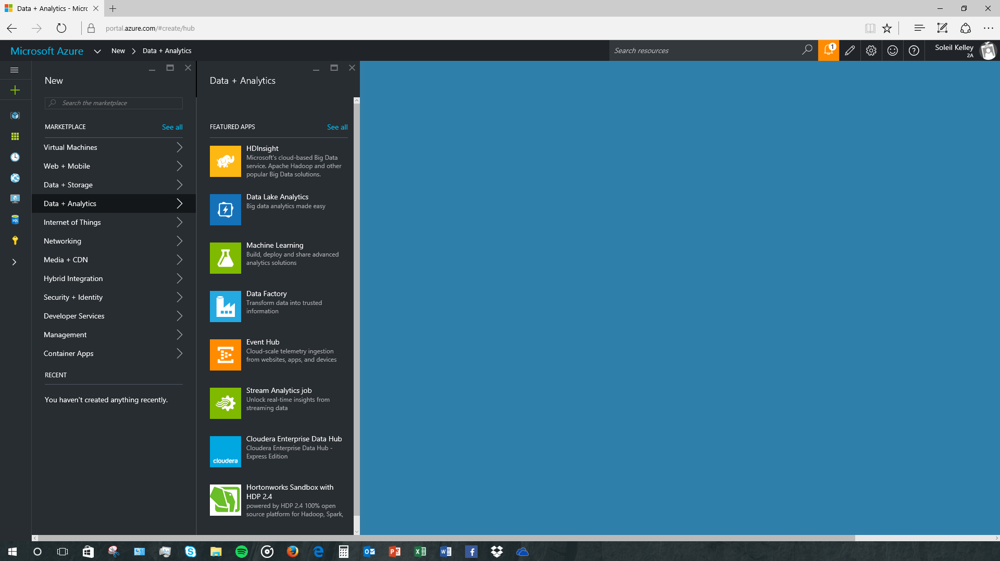

Workshop
E2E Embedding Reports
Power BI
Add Power BI reports and datasets to your application

Slide 23
Change the game with the complete array of Azure Services
Your app
Azure services
Data and storage
Analytics
Internet of things
Access management
SQL DB
Document DB
Blob Storage
StorSimple
SQL Data Warehouse
Power BI Embedded
Data Lake Analytics
Data Lake Store
HDInsight
Stream Analytics
IoT Hub
Event Hubs
Machine Learning
Notification Hubs
Azure Active Directory
Multi-factor authentication
Create
Embed
Deploy
Notes:
Key e2e differentiating capability on Microsoft Online
No other public cloud provider offers BI consumption services

Slide 24
Developer resources
Home page
https://azure.microsoft.com/services/power-bi-embedded
Developer center
http://dev.powerbi.com
Developer blog
http://blogs.msdn.com/powerbidev
Samples
https://github.com/Azure-Samples/power-bi-embedded-integrate-report-into-web-app/
Open source visuals
http://github.com/Microsoft/PowerBI-visuals
Visuals gallery
http://visuals.powerbi.com
Ask us questions
http://stackoverflow.com/questions/tagged/powerbi

Slide 25
Notes:
Dark gray background.

Slide 26

What if your app could put the power of analytics everywhere decisions are made?
Modern apps with data visualizations built-in have the power to inform decisions in context—
for any user on any device

Slide 27

Create compelling interactive reports that are always up to date
Author interactive reports without writing any code
Choose modern visualizations out-of-the-box or customize without building them from scratch
Visualize any data from a variety of cloud sources
Keep your data always-up-to-date with DirectQuery
Create
Embed
Deploy

